Slide 1
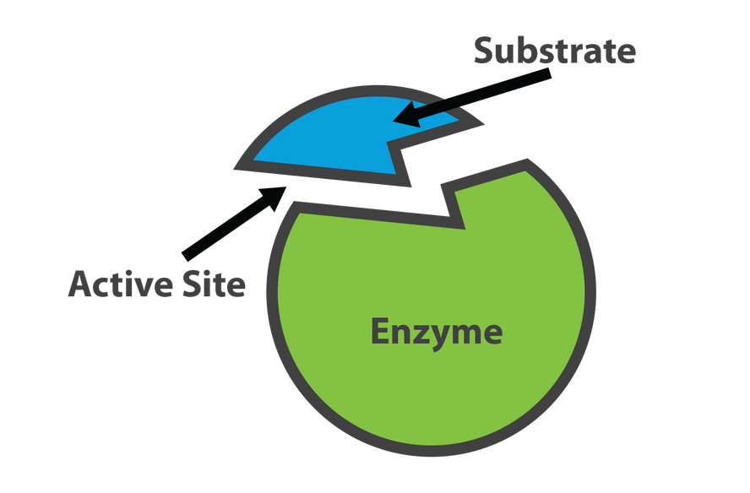
enzymes
BIO CATALYSTS

Slide 2
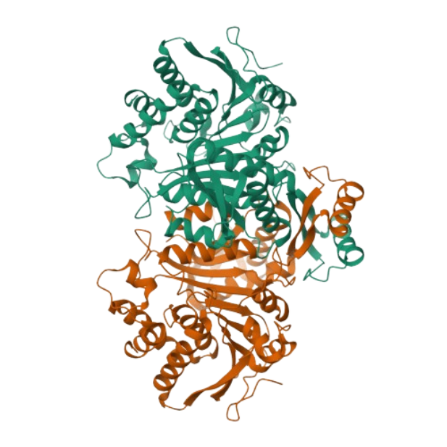
introduction
Enzymes are biological catalysts that speed up the rate of the biochemical reaction.
They speed up chemical reactions by lowering the activation energy required.
Most enymes are 3D globular proteins.

Slide 3

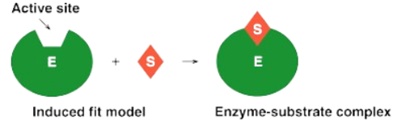
structure of enzymes
The Active site of an enzyme is where it binds substrates and other molecules needed for reactions, with specific residues helping to hold them in place.
Active sites occupt less than 5% of the total surface area of enzyme.
Active site has a specific shape due to tertiary structure of protein.
A change in the shape of protein affects the shape of active site and function of the enzyme.

Slide 4
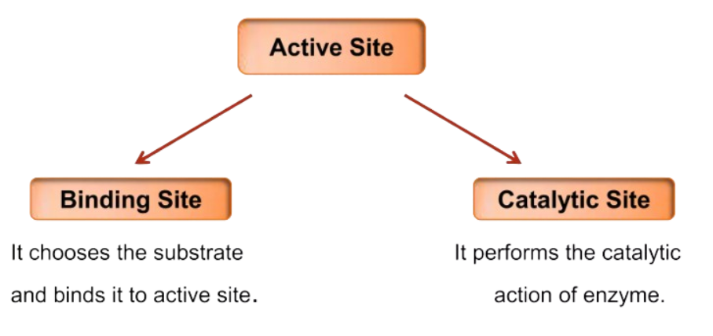
active site
Active site can be further divided into:

Slide 5
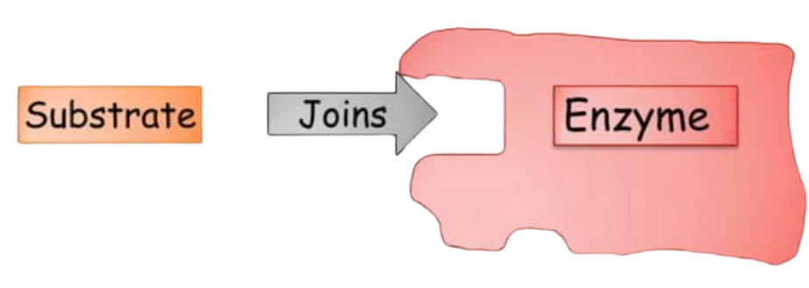
substrate
The reactant in biochemical reaction is termed as substrate.
When a substrate binds to an enzyme it forms an enzyme-substrate complex.

Slide 6
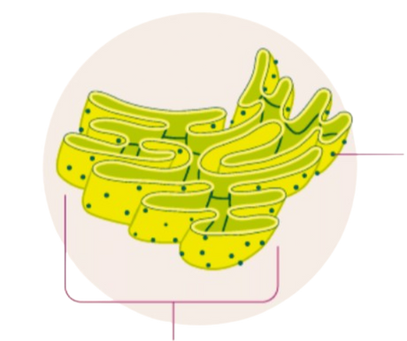
sites of enzyme synthesis
Enzymes are synthesized by Ribosomes which are attached to the rough endoplasmic reticulum.
Information for the synthesis of enzyme is carried by DNA.
Amino acids are bonded together to form specific enzyme according to the DNA’s codes.
Ribosome
Endoplasmic Reticulum

Slide 7
characteristics
Enzymes speed up the reaction by lowering the activation energy of the reaction.
Their presence does not effect the nature and properties of end product.
Small amount of enzymes can accelerate chemical reactions.
Enzymes are sensitive to change in pH, temperature and substrate concentration.
Each cell contains thousands of different enzymes.

Slide 8
nomenclature of enzymes
An enzyme is named according to the name of the substrate it catalyses.
-ase is added at last (suffix) of the name of the substrate.
Examples:
- maltase
- lactase
- lipase
- amylase

Slide 9
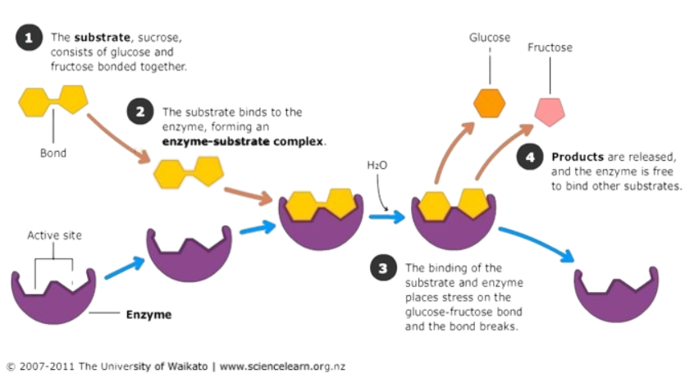

Slide 10
done by
ROHAN D RA2311003010008
BHARATH K RA2311003010009
VARUNA MOORTHY RA2311003010026
PRAKALYA M RA2311003010031
NIRANJAN B RA2311003010050
NAVEEN K G RA2311003010052
ANTO JENICKS RA2311003010059
SAMEER S RA2311003010062

Slide 11
THANK YOU

